Slide 1
Fleet Monitoring System
Client/Advisor: Lotfi Ben-Othmane
Team Members: Lorenzo Chavarria, Nicolas De la Cruz, Joe Herrera, and Marco Yepez-Gomez

Slide 2
The Problem

Slide 3
Companies have fleets that need to be monitored and tracked for administrative purposes. Not addressing these issues, a companies can have negative impacts in the following areas:
Risks
Efficiency
Productivity

Slide 4
Solution

Slide 5
A solution to the problem would be to provide different services to the users. This entails developing a server application, necessary hardware, and front-end applications
OBD Status
GPS Tracking
Data Visualization

Slide 6
Deliverables

Slide 7
Web Application
Mobile Application
PiCAN
Server
Database

Slide 8
Embedded Systems

Slide 9
Overview
1
2
3
Refactor the Use of Threads
Adapted a New Design
Updated the Use of API

Slide 10
Main Components
PiCAN
OBD Simulator
GPS Device

Slide 11
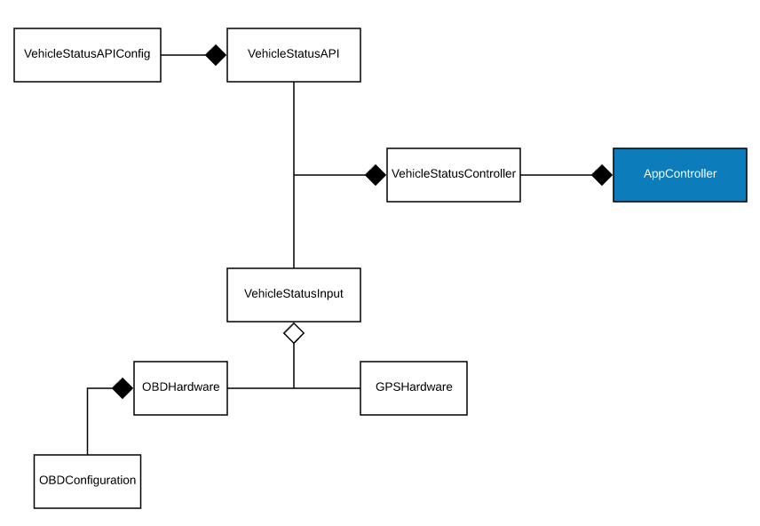
Design

Slide 12
Server

Slide 13
Overview
1
2
3
MongoDB
Migrated Server from DigitalOcean to ISU Servers
Tested Microservices Using Postman

Slide 14
Main Components
ISU Server
NodeJS
Microservices

Slide 15
Web Application

Slide 16
Overview
1
2
3
Created a Layout for web app and design for each page
Implemented Sign Up/Log In
Started Real-time Data page

Slide 17
Main Components
Node.js and Express.js
Bootstrap
Google Maps Js Api and Chart.js

Slide 18
Mobile Application

Slide 19
Overview
1
2
3
Designed New Mobile Application
Implemented Login and Signup
Created a Vehicle Status Dashboard

Slide 20
Main Components
Android Studio
Volley HTTP Library
Postman

Slide 21
Main Components
Android Studio
Volley HTTP Library
Postman

Slide 22
Demo

Slide 23
Login

Slide 24
Sign Up

Slide 25
OBD Status Display

Slide 26
What’s Next?

Slide 27
1
2
3
Implement Internal Chat
Real-Time GPS Tracking
Enhance Data Visualization

Slide 28
Thank You

